Slide 1
steganography – Hiding Information in the Image
CAPSTONE PROJECT
Presented By:
Student Name-Janagam Sai Teja
College Name-Vaagdevi Engineering College
Department-CSE(AI&ML)

Slide 2
OUTLINE
Problem Statement
System Development Approach
Algorithm & Deployment
Result
Conclusion
Future Scope
References

Slide 3
Problem Statement
Problem Statement: In today’s digital world, the need for secure and private communication has become increasingly important due to the growing threats of data interception, unauthorized access, and surveillance. Traditional methods of securing data often make the presence of confidential information obvious, attracting attention and making it a target for malicious attacks. There is a significant challenge in transmitting sensitive information in a way that conceals not only the content but also the very existence of the data. This project aims to address the problem of how to embed confidential information within a digital medium such that its presence remains undetectable to unintended recipients, ensuring privacy and confidentiality during communication or storage.

Slide 4
System Approach
The system approach for this project outlines the strategy and technical workflow used to develop, test, and implement a steganography-based application that hides information inside images. The project follows a modular and structured methodology, beginning from requirement analysis to final testing and deployment. Below is the breakdown of the key components:
System Requirements: Hardware Requirements: Processor: Intel i3 or higher RAM: Minimum 4 GB (8 GB recommended) Software Requirements: Operating System: Windows / Linux / macOS Python Version: Python 3.7 or above
Libraries Required to Build the Model To build the steganography model, the following Python libraries and modules are used: Library Purpose Pillow (PIL):For image loading, editing, and saving NumPy :For numerical operations and pixel-level manipulation Tkinter :To create a GUI interface for user input and image handling

Slide 5
Algorithm & Deployment
Encoding (Hiding the Data) process with each main heading followed by a single, concise point that summarizes the step: 1. Import Required Libraries Import Python libraries like Pillow, NumPy, and os to handle image processing and file operations. 2. Load the Original Image Open the original image using the Pillow library, preferably in PNG format to preserve quality during data embedding. 3. Input Secret Message Collect the message or data from the user that needs to be hidden inside the image. 4. Convert Text to Binary Transform the secret message into a binary string using text encoding methods such as ASCII or UTF-8. 5. Add a Delimiter Append a unique delimiter (e.g., #####) to the binary message to indicate the end of hidden data during decoding. 6. Embed Binary into Image Pixels Modify the Least Significant Bit (LSB) of the image’s RGB pixel values to embed each bit of the binary message. 7. Save the Stego Image Save the modified image with a new name to preserve the original and store the hidden message securely

Slide 6
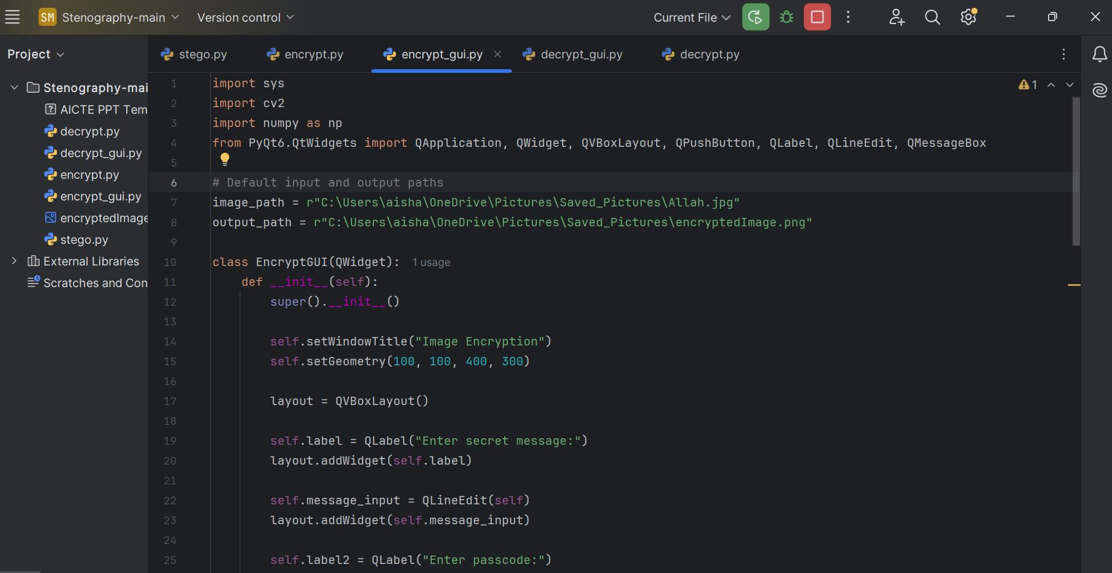
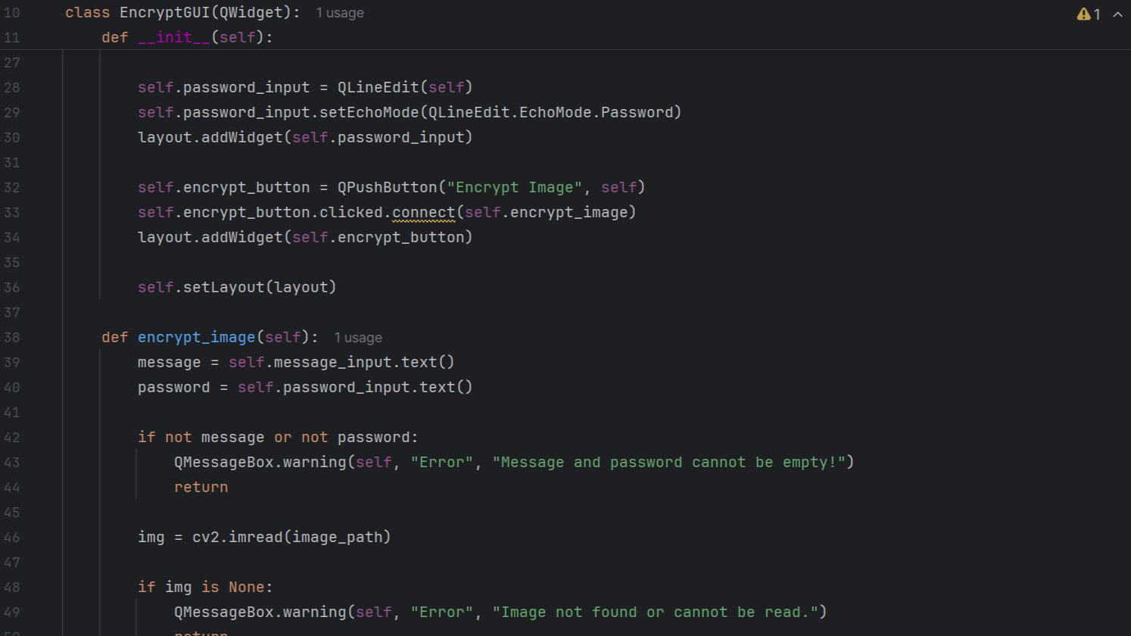
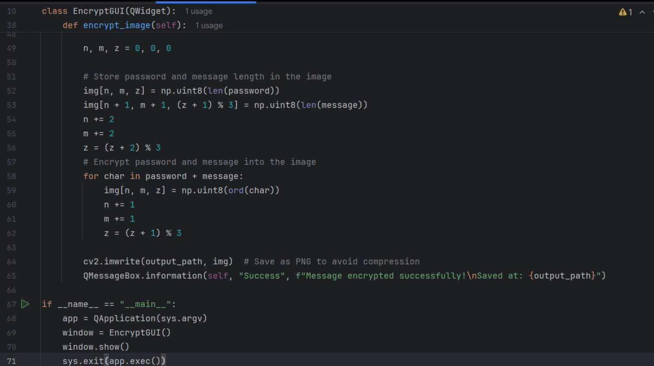
Result
encryption code

Slide 7
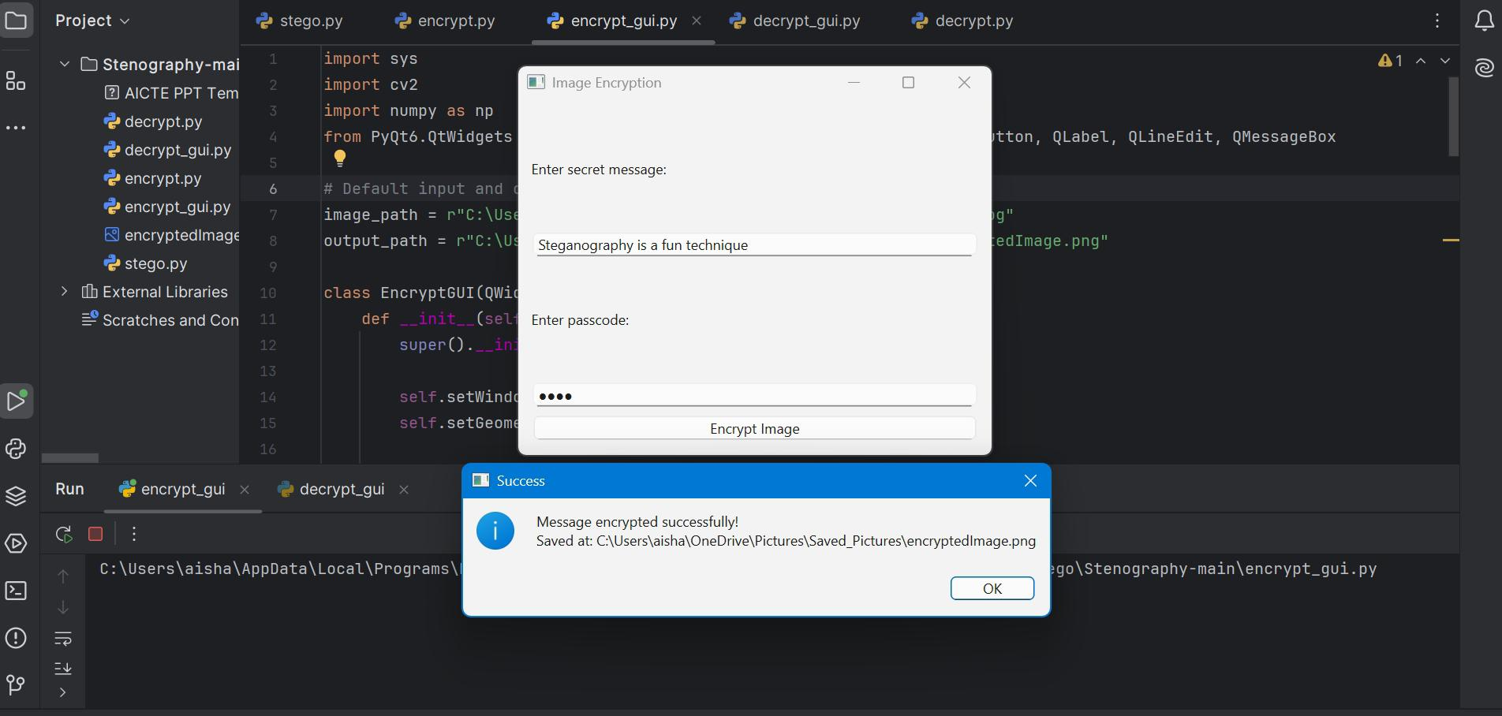
encryption Output

Slide 8
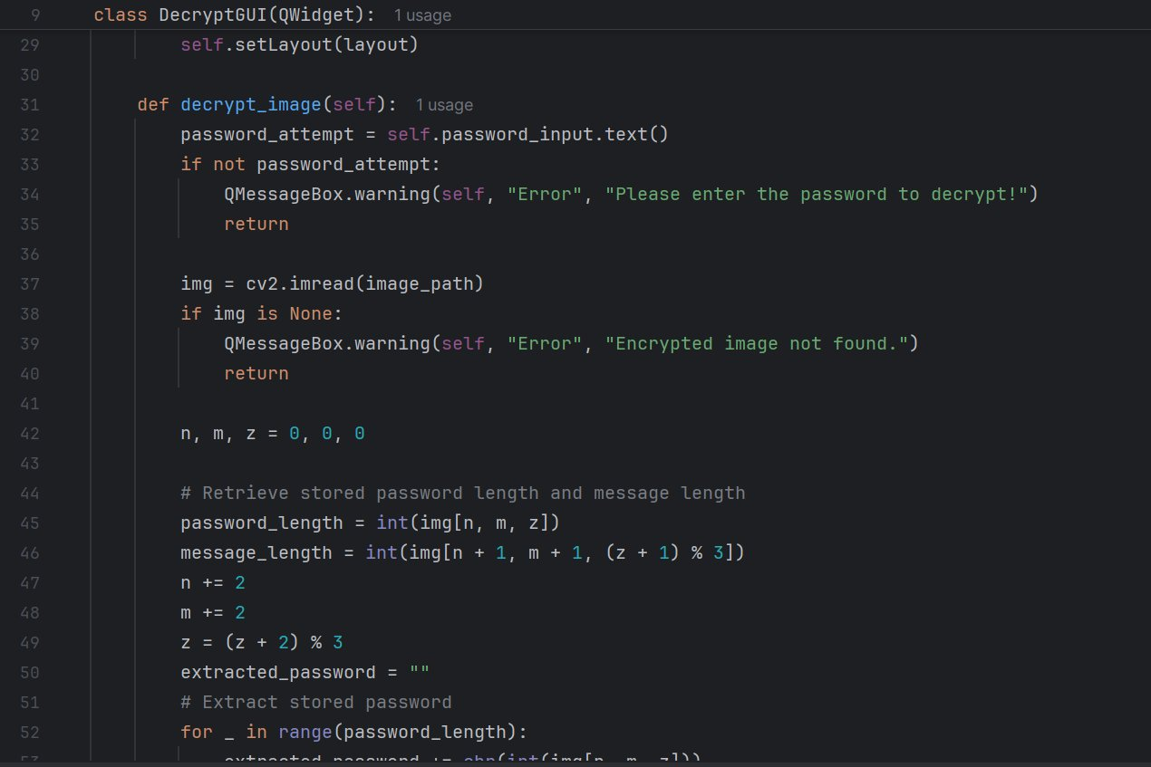
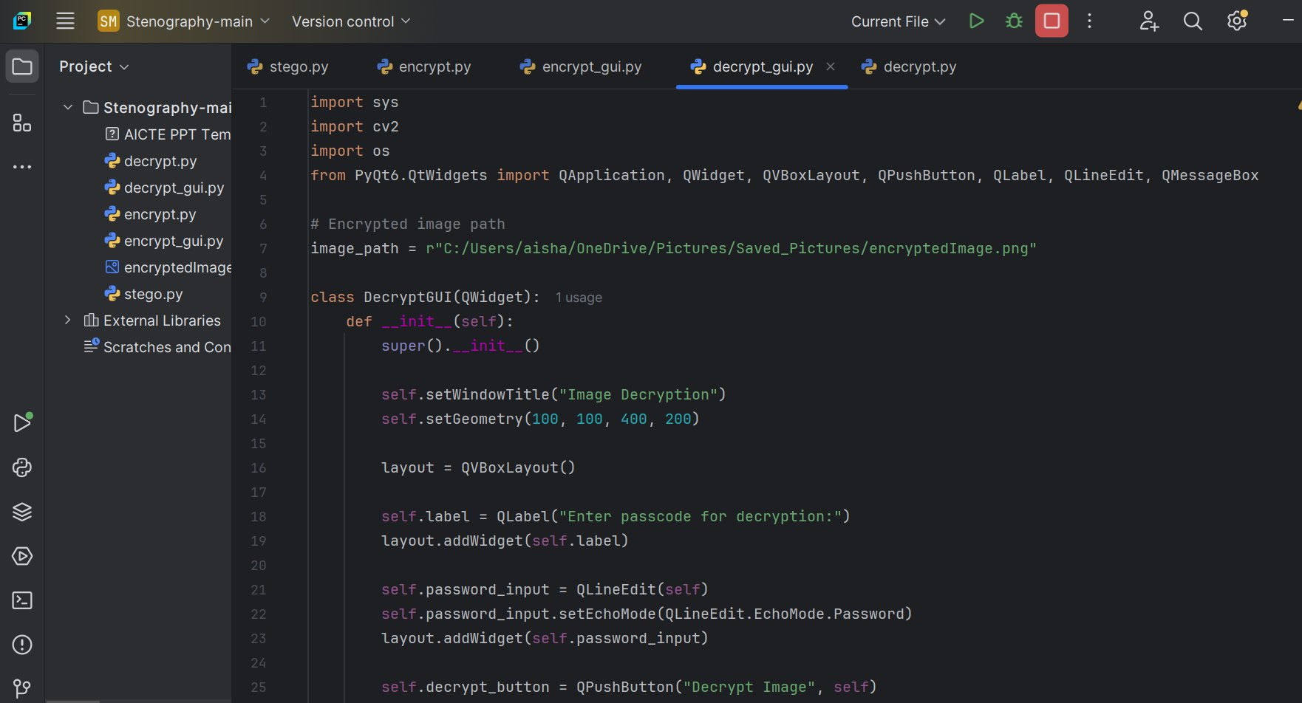
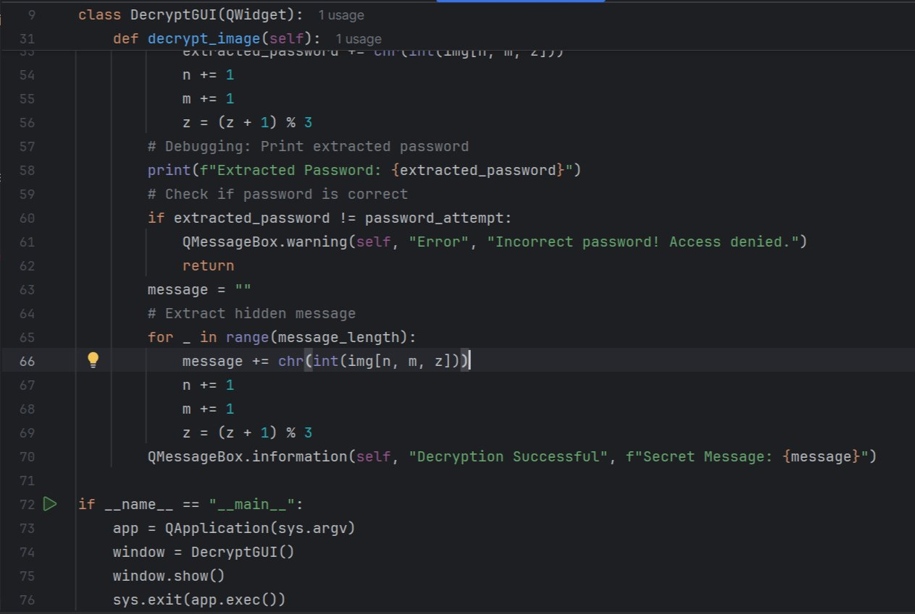
Decryption Code

Slide 9
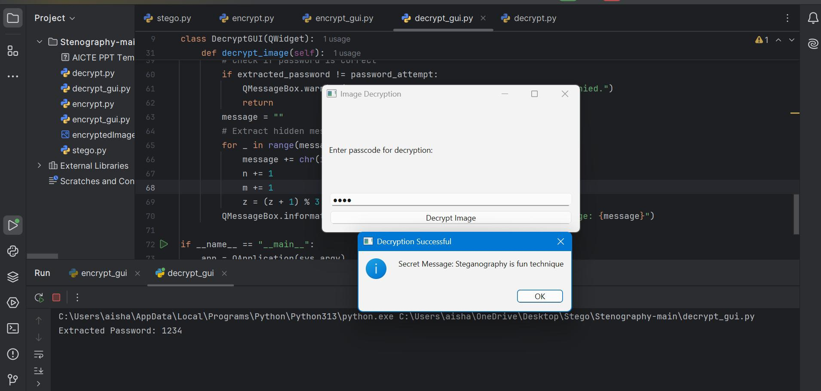

Decryption Output
Encrypted Image

Slide 10
GITHUB LINK
https://github.com/jsaiteja4074/Steganography---Hiding-Information-in-the-Image-Project.git

Slide 11
Conclusion
In conclusion, this project successfully demonstrates how steganography can be effectively used to hide secret information within an image using the Least Significant Bit (LSB) technique. By embedding data in such a subtle way that the human eye cannot detect any visual difference, the project ensures both confidentiality and discretion during data transmission. The implementation in Python, supported by libraries like Pillow and NumPy, makes the process efficient and lightweight. This method serves as a practical approach for secure communication, especially in situations where hiding the existence of data itself is critical. While the current model handles basic text hiding, it also lays a strong foundation for future enhancements such as encryption integration, password protection, or extending the technique to other media like audio or video

Slide 12
Future scope:
The steganography project offers significant potential for future enhancements and real-world applications. One major area of improvement is integrating encryption algorithms such as AES or RSA before embedding the message, adding a second layer of security. Password protection and authentication features can also be introduced to prevent unauthorized access during decoding. Additionally, the system can be extended to support other media formats such as audio, video, or even PDF documents, increasing versatility. Implementing robust steganalysis resistance techniques can help avoid detection from advanced analysis tools. Finally, deploying the project as a web or mobile application with an intuitive user interface would make it more accessible and practical for wider usage in secure communication.

Slide 13
References
1. Pillow (PIL) – Python Imaging Library [https://pillow.readthedocs.io/en/stable/](https://pillow.readthedocs.io/en/stable/) 2. NumPy – Numerical Python Library [https://numpy.org/doc/](https://numpy.org/doc/) 3.Steganography Techniques – Research Paper Johnson, N. F., & Jajodia, S. (1998). *Exploring Steganography: Seeing the Unseen*. IEEE Computer, 31(2), 26–34. [https://ieeexplore.ieee.org/document/646971](https://ieeexplore.ieee.org/document/646971) 4.RealPython – Image Processing with Pillow in Python [https://realpython.com/image-processing-with-the-python-pillow-library/](https://realpython.com/image-processing-with-the-python-pillow-library/) 5. GeeksforGeeks – Introduction to Steganography [https://www.geeksforgeeks.org/steganography-introduction/](https://www.geeksforgeeks.org/steganography-introduction/) 6. Python Official Documentation [https://docs.python.org/3/](https://docs.python.org/3/) 7. GitHub – Example Projects on LSB Steganography [https://github.com/topics/steganography](https://github.com/topics/steganography)

Slide 14
THANK YOU

